Slide 1

Final year computing project – lecture 2
Dr. Mark Dixon (Module Leader)
Caedmon 118
With significant contribution
from Maurice Calvert
Mark Dixon Leeds Beckett University

Slide 2
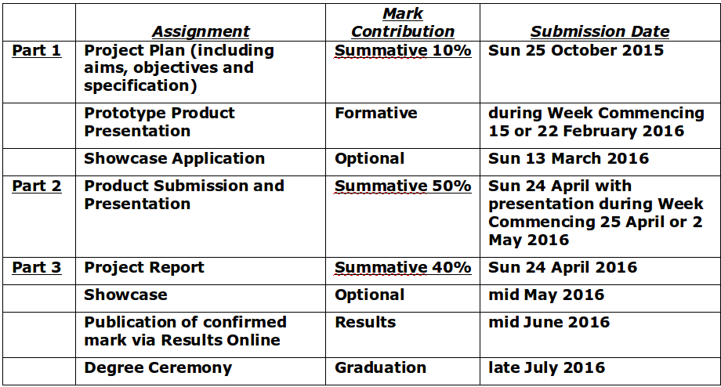
Level 6 projects – assessment
Mark Dixon Leeds Beckett University

Slide 3
Assessment – Semester 1
Project Plan Required Content
A Title for your Project.
An overall Aim for your Project.
Objectives for the whole of your Project.
Product Specification – as much detail as you can provide.
A portfolio of Project Planning Documents.
A list of Physical Resource requirements.
A list of Human Resources
An initial Bibliography

Slide 4
Assessment – Semester 2
Week 3 or 4 – Prototype Product Presentation (formative assessment for feedback)
Week 7 – submit your Showcase Application
Week 10 – submit your final Product and final Report
Week 11 or 12 – Product Presentation
Weeks 13/14 – final assignments for other modules
SHOWCASE (mid-may)
Notes:
4

Slide 5
Assessment – Semester 2
Prototype Product Presentation
this is a formal presentation at which you can confirm progress with implementing your product on schedule and gain feedback from your supervisors – it’s an opportunity to practise your presentation skills before the assessed Product Presentation
Product Submission + Presentation (50%)
the presentation of your product is a chance to show your achievements and to gain formal feedback and evaluation from your supervisors.
Project Report (40%)
a report on the whole of your project but, in particular, describing the research, implementation, and an evaluation of the product and project.
Notes:
5

Slide 6
Detail for project plan
A Title for your Project.
How long?
An overall Aim for your Project.
One or two sentences
Objectives for the whole of your Project.
Approx. 8 to 12 (2-4 weeks work for each?)
Arrange logically
Ensure you can measure completion
Relate to your WBS and plan – each objective will become several tasks

Slide 7
More on project plan
Product Specification – your Final Product.
Write down what it will be (in detail) (bullet points?)
A portfolio of Project Planning Documents.
Project Charter
Project Scope
WBS
Gantt Chart
Backup plan
Communication plan
Documentation standards
more …

Slide 8
More on project plan
A list of Physical Resource Requirements.
be aware of any special equipment (hardware or software) – can you get regular use of it?
A list of Human Resources.
all the people involved in your project
An initial Bibliography of authoritative sources
must be in correct format (approx. 10+)

Slide 9
Project Plan Submission
Submit by end of week 4 (25th oct) via VLE
Supervisors will look at draft during tutorial sessions before the hand-in (look, not mark!)
MS-Office or pdf only
– Windows zip files – OK
– NOT rar files
– NOT MS-project or other specialist software
– if you use other formats, your work will not be marked.

Slide 10
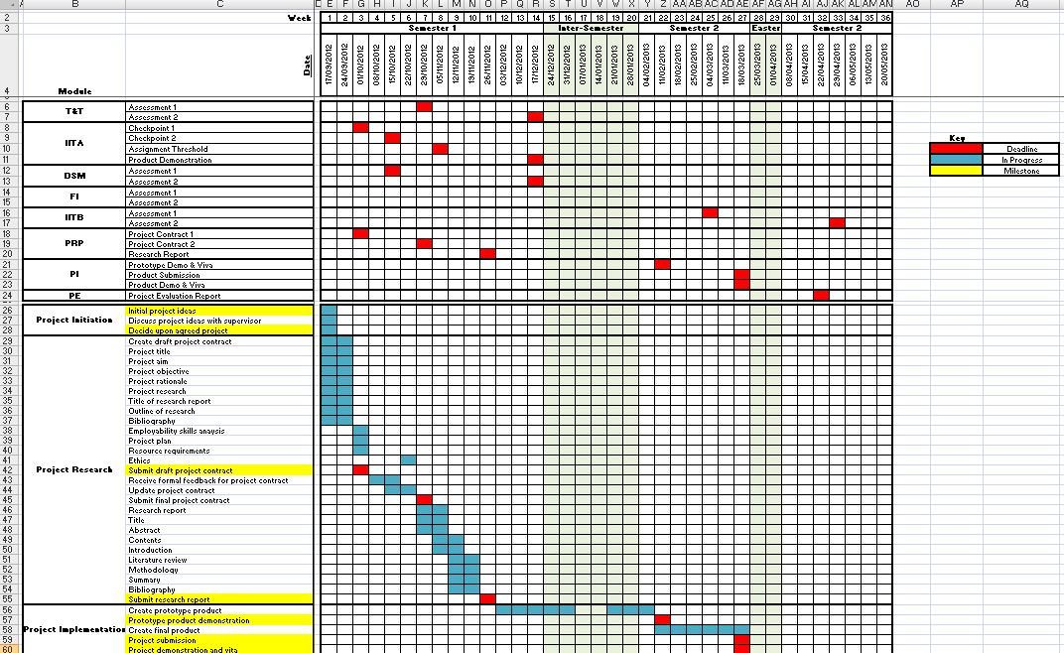
Plan the whole year

Slide 11
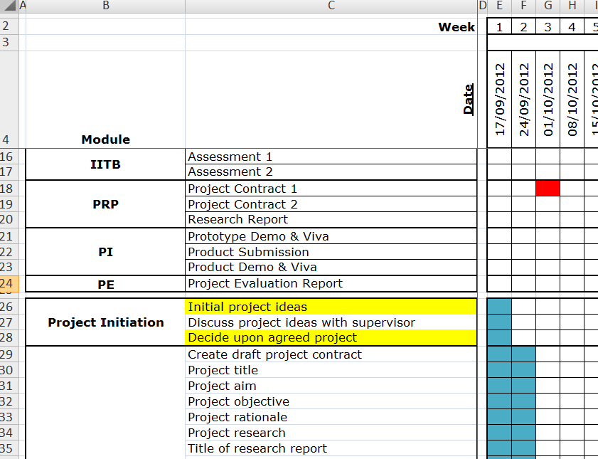
Plan for your year!

Slide 12
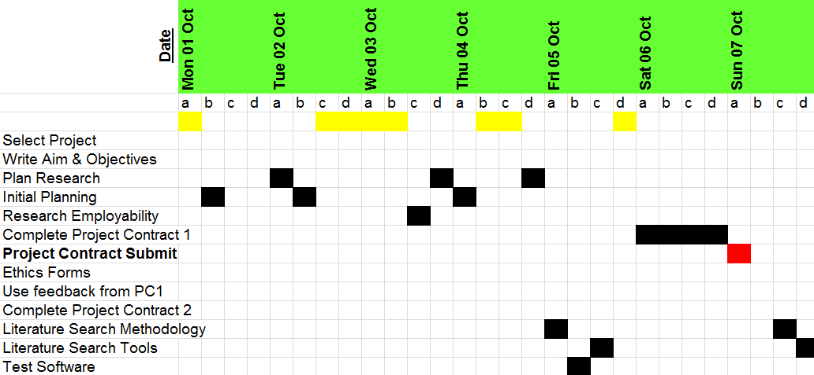
Plan for EACH week

Slide 13
Ethics
Every profession expects you to act ethically – there are often ethical guidelines which you are expected to follow.
The University takes ethical issues very seriously and expects every Level 6 student to consider the ethics of their project.
The University uses an online system, which you MUST use as part of the project contract phase.
https://www.leedsbeckett.ac.uk/studenthub/research-ethics.htm
Notes:
13

Slide 14
Research Should
Benefit society by adding to human knowledge.
Avoid or minimise harm.
Give due consideration to “informed consent” with regard to everyone involved in the research
Respect issues around confidentiality and anonymity.
Research outcomes must be disseminated appropriately and their independence must be protected.

Slide 15
Research Should Not
‘Steal’ by plagiarising or claiming as your own, the work of others.
Submit data if you have questions about its accuracy.
Misrepresent opposing views.

Slide 16
BCS code of conduct see http://www.Bcs.Org/category/6030
Sets out the professional standards required by BCS as a condition of membership
Applies to all members
Governs the conduct of the individual, not the nature of the business
You need to refer to BCS as the “Learned Society” as part of the Online Ethics form.
Notes:
16

Slide 17
BCS code of conduct see http://www.Bcs.Org/category/6030
FOUR MAJOR HEADINGS
Public Interest
Professional Competence and Integrity
Duty to Relevant Authority
Duty to the Profession
Notes:
17

Slide 18
BCS code of conduct see http://www.Bcs.Org/category/6030
INCLUDED WITHIN THESE:
Public Interest
c) conduct your professional activities without discrimination on the grounds of sex, sexual orientation, marital status, nationality, colour, race, ethnic origin, religion, age or disability, or of any other condition or requirement
Notes:
18

Slide 19
BCS code of conduct see http://www.Bcs.Org/category/6030
INCLUDED WITHIN THESE:
Professional Competence and Integrity
b) NOT claim any level of competence that you do not possess.
c) develop your professional knowledge, skills and competence on a continuing basis, maintaining awareness of technological developments, procedures, and standards that are relevant to your field.
e) respect and value alternative viewpoints and, seek, accept and offer honest criticisms of work.
Notes:
19

Slide 20
BCS code of conduct see http://www.Bcs.Org/category/6030
INCLUDED WITHIN THESE:
Duty to Relevant Authority
c) accept professional responsibility for your work and for the work of colleagues who are defined in a given context as working under your supervision.
d) NOT disclose or authorise to be disclosed, or use for personal gain or to benefit a third party, confidential information except with the permission of your Relevant Authority, or as required by Legislation
Notes:
20

Slide 21
BCS code of conduct see http://www.Bcs.Org/category/6030
INCLUDED WITHIN THESE:
Duty to the Profession
b) seek to improve professional standards through participation in their development, use and enforcement.
Notes:
21

Slide 22
Ethics
The University Online Ethics system is at: https://www.leedsmet.ac.uk/studenthub/research-ethics.htm
You MUST complete this as part of your Part 1 Assessment (Project Plan).
This MUST be completed before you engage in your detailed research.
If the project changes significantly you may need to resubmit a new ethics form.
You could spend many hours reading all the documentation – DON’T!
But, DO fill in the forms as well as you can.
Notes:
22

Slide 23
Ethics
Don’t get involved in too much detail – in most cases, you can paste your answers from your Project Plan into the answer boxes.
DO treat it seriously and discuss with your supervisor.
The Online system was new in the last few years and is simpler than working with Word documents.
Without this submission, you cannot proceed with your research or submit the Project Report.
Notes:
23

Slide 24
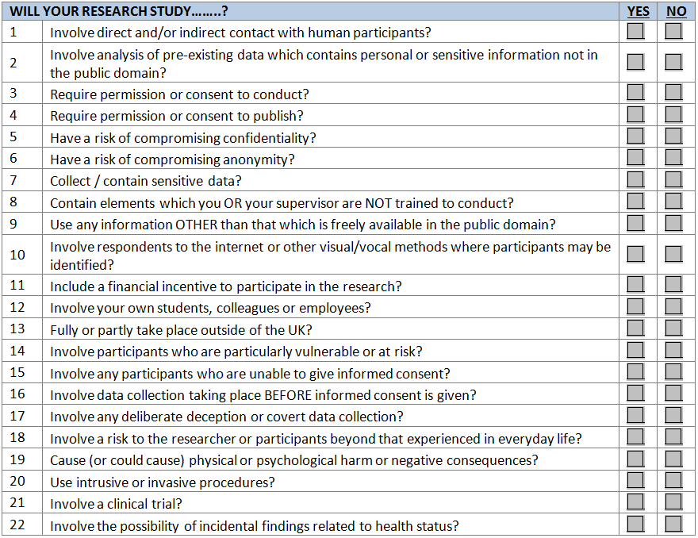
Risk checklist:

Slide 25
Ethics
You must be able to answer “No” to questions 14 to 22, otherwise, you will not be allowed to do your project (these questions are for research students and staff, not undergraduates).
Q1 and Q14 are defining questions for many projects:
Will your Research Study ...
Q1 – “Involve direct and/or indirect contact with human participants?”
Notes:
25

Slide 26
Ethics
Will your Research Study ...
Q14 “Involve participants who are particularly vulnerable or at risk?”
“vulnerable or at risk” means anyone under 18 and vulnerable adults
undergraduates are not allowed to do this sort of research
you can work with people who are qualified to work with others “vulnerable or at risk”, for example, you could ask a school teacher to test your website with some children.
Notes:
26

Slide 27
Ethics
If you answer “No” to all questions (1 to 22), your project is Risk Category 1.
This is only likely to be true if you are working on a project with no-one involved but you and your supervisors.
If you answer “Yes” to any question Q1 to Q13, your project is Risk Category 2.
Notes:
27

Slide 28
Ethics
Some project are Risk Category 2.
Typically this means it involves “human participants” other than your supervisors. For example, if you have someone to provide a specification for your product or if you are going to use a questionnaire or interview people.
An exception is, if the people are ONLY involved in evaluation of your product but not at any earlier stage, that is, they are not involved in the research or design.
Notes:
28

Slide 29
Ethics
Learned Society
You must confirm that “I have read an appropriate professional or learned society code of ethical practice”.
In all cases the “Learned Society” is the BCS – Chartered Institute for IT.
The “code of ethical practice” is the BCS Code of Conduct.
Notes:
29

Slide 30
Information sheets and consent forms
for Risk Category 2 Projects
You need to create, as a minimum, an Information Sheet and a Consent Form.
On the Templates link on MyBeckett, you will find a document containing some “useful statements” which you can build in to your documents.
Discuss this at your Project Tutorials with each other and with your supervisors.
If you do not include these, the research ethics coordinator will probably reject your ethics application
Notes:
30

Slide 31
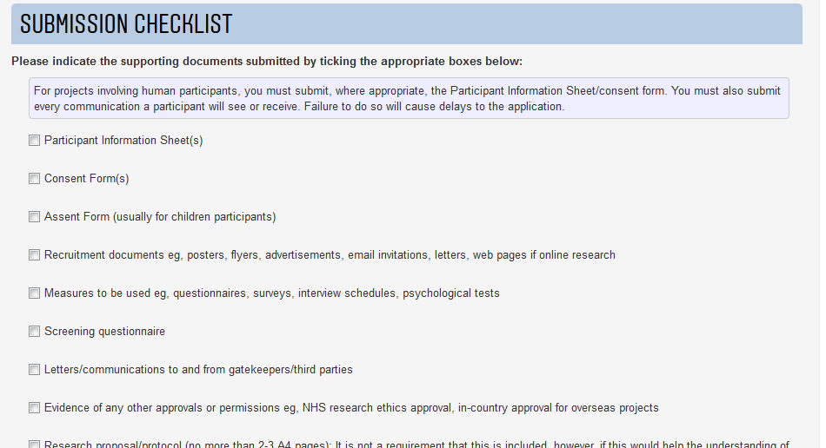
Information sheets and consent forms
Notes:
31

Slide 32
Summary
Getting the project plan right is important for the whole project (not just for 10% of the marks)
A clear aim and appropriate supporting objectives make a project run much smoother
Keep the plan up to date, even after submission
Updated elements from the plan, including changes etc. may be submitted as an appendix of the final report
Work hard to get this right, it will impact your whole degree!
Get a draft ready and show it to your supervisor before submission.
Notes:
32

